Slide 1
Access to Azure VMs
Using MS account
Version 1.0

Slide 2
Step 1: install the Azure CLI
https://learn.microsoft.com/en-us/cli/azure/install-azure-cli
Install on Windows
Install on macOS
Step 2: az login
Step 3: az ssh vm –n EVCO-OS-1 -g EVCO_OS
(az ssh vm --resource-group myResourceGroup --name myVM)

Slide 3
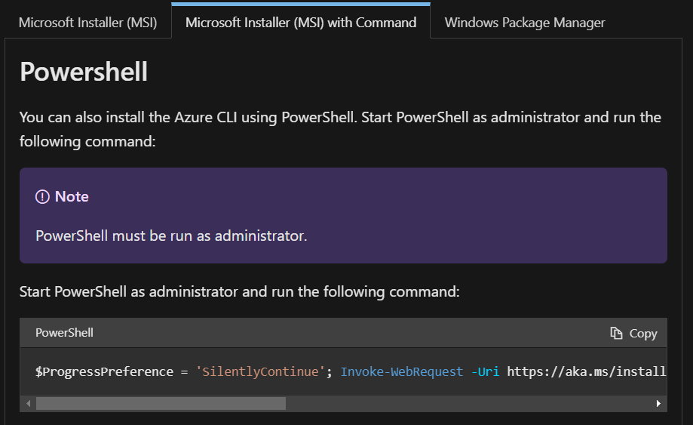
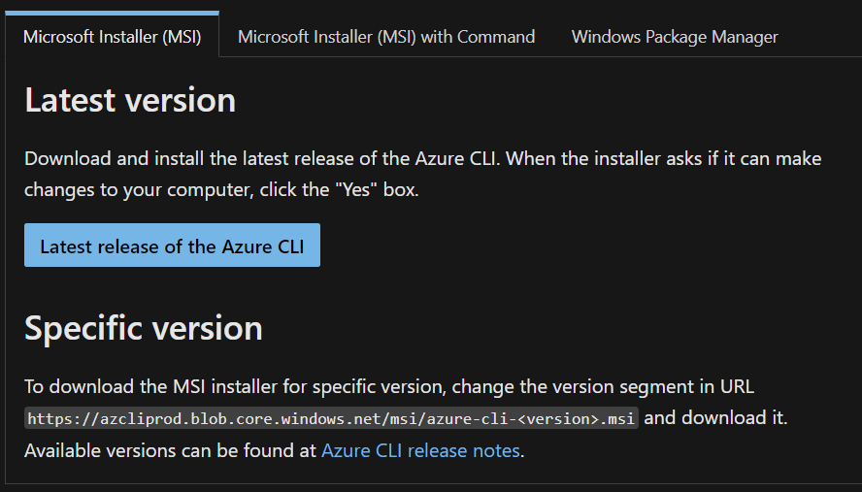
AZ CLI Install on Windows
$ProgressPreference = 'SilentlyContinue'; Invoke-WebRequest -Uri https://aka.ms/installazurecliwindows -OutFile .\AzureCLI.msi; Start-Process msiexec.exe -Wait -ArgumentList '/I AzureCLI.msi /quiet'; rm .\AzureCLI.msi

Slide 4
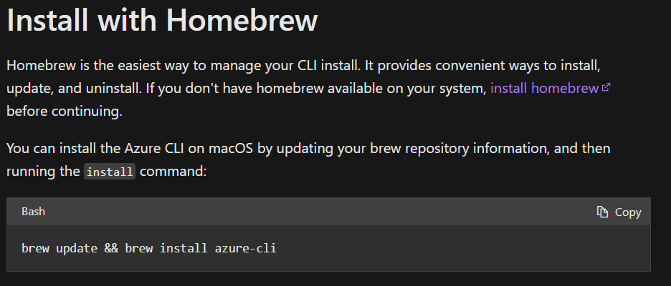
AZ CLI Install on macOS
install homebrew
https://docs.brew.sh/Installation.html

Slide 5
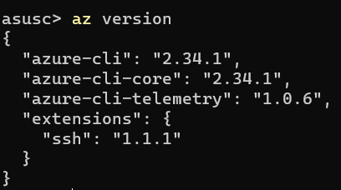
After you have installed the az cli - verify

Slide 6
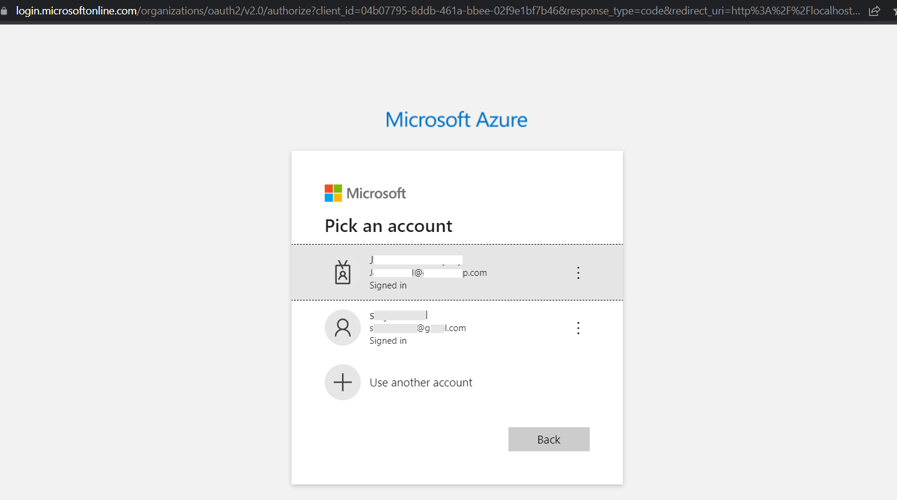
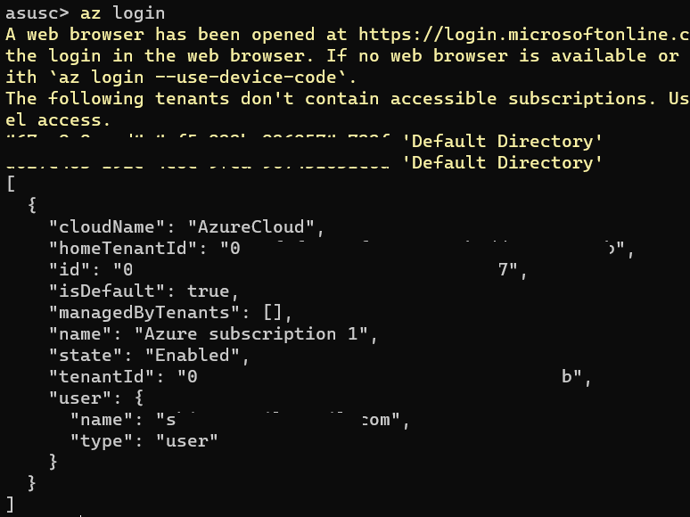
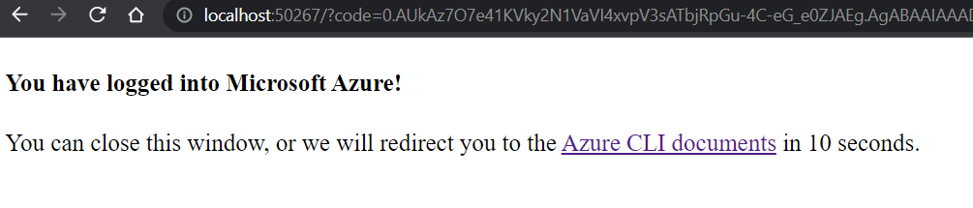
Step 2: az login

Slide 7
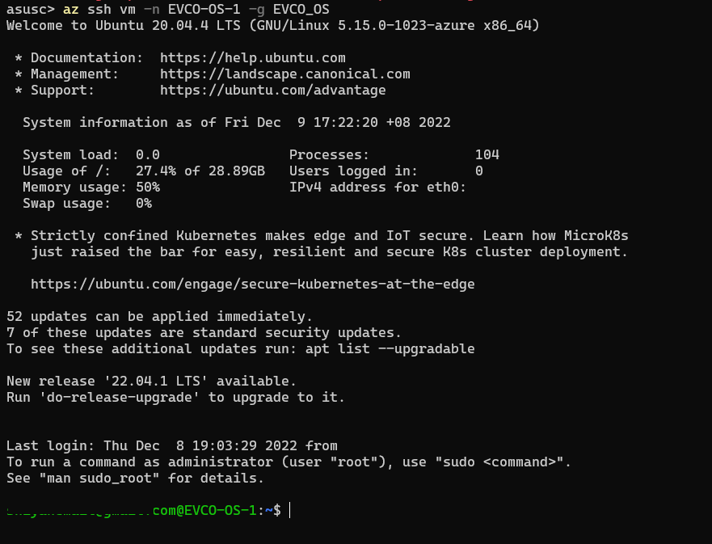
Step 3: az ssh vm –n EVCO-OS-1 -g EVCO_OS

Slide 8
List of VMs
asusc> az vm list -g EVCO_OS -otable
Name ResourceGroup Location Zones
------------- --------------- ------------- -------
EVCO-OS-1 EVCO_OS eastasia
EVCO-OS-UAT01 EVCO_OS southeastasia
EVIE EVCO_OS southeastasia
asusc> az vm list -g EVCO_PROD_RG -otable
Name ResourceGroup Location Zones
---------------- --------------- ------------- -------
EVCO-DEMO-SC01 EVCO_PROD_RG southeastasia
EVCO-PROD-APP01 EVCO_PROD_RG southeastasia 2
EVCO-PROD-CICD01 EVCO_PROD_RG southeastasia 2
asusc> az vm list -g DARG -otable
Name ResourceGroup Location Zones
------------- --------------- ------------- -------
datacollector DARG southeastasia

